Slide 1
Numerical Analysis
Introduction to MATLAB
Lab1

Slide 2
MATLAB
MATLAB==MATrix LABoratory
  It is a mathematical package based on matrices and consists of extensive library of numerical routines.
All Data stored in the form of a matrix
High-Level programming language and Matrix based computing environment
Visualization of data
  Advanced graphics two and three dimensional

Slide 3
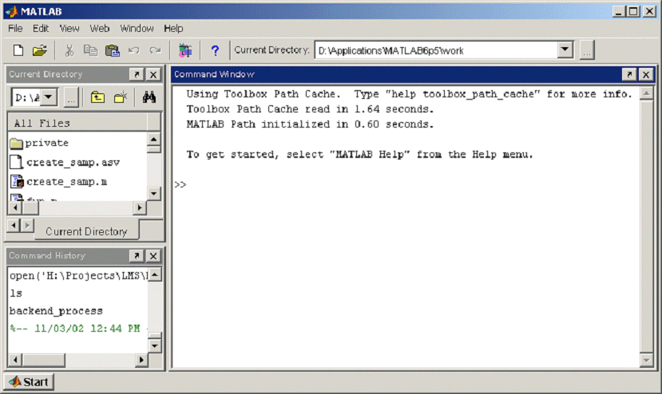
Run MATLAB
From Start Menu
  Select Programs
  Select MATLAB
MATLAB Prompt
Tells that MATLAB is ready for your command

Slide 4
MATLAB Layout
Different windows can be selected to appear (View)
Current
directory
window
Command
History
window
Command
window

Slide 5
MATLAB AS A CALCULATOR
Command window
>> 39*4.4+5
ans =
176.6000
The MATLAB command
Command window
The result.

Slide 6
Variables MATLAB
no declaration of variables (matrix is the key-word)
  Variables are defined by assignment
Variable names:
  Starts with a letter
  Up to 31 characters ( some use 19 or 21)
  May contain letters, digits and underscore_
  Case sensitive (“A” is not the same as “a”
A scalar is a single number and is represented by a 1 x 1 matrix in matlab.
A vector is a one dimensional array of numbers and is represented by an n x 1 column vector or a 1 x n row vector of n elements
Semicolon at the end of a statement stop to show output

Slide 7
Variables in MATLAB (…cont)
Assignments are done by = ended by Enter
    >>A = 7.5*2
    >>7.5*2 (result in ans), ans is a variable
Comments start with % for the rest of the line
Comments block %{ statements %}
Possible to handle complex numbers
  Basic imaginary unit SQRT(-1) denoted either by i or j
    >>i >>j

Slide 8
MATLAB Commands
whos
  Show a list of variables in Workspace (with detail)
who
  Show a list of variables name current session
what
  Show all M-files in the current directory ( Z:\ )
    example1 example2 example3
pwd
  Show current working directory path (Z:\ )
clear
  clears a variable from the workspace

Slide 9
MATLAB Assignment
Variable names:
  Starts with a letter
  Up to 31 characters ( some use 19 or 21)
  May contain letters, digits and underscore_
  Case sensitive (“A” is not the same as “a”)
» A=2.3
A =
2.3000
The MATLAB command
This is the result of the MATLAB statement

Slide 10
Scalar Assignment
» A=2.3
A =
2.3000
this creates a variable “A” and set its value to 2.3
» A=[2.3]
A =
2.3000
The square braces [ ] are used to define matrices. We can use them for scalars too.

Slide 11
Create a matrix
Simplest way to create matrix is to use the constructor operator [].
Elements are separated by comma or space
    row = [E₁, E₂, … E_{m}] or row = [E₁ E₂ … E_{m}]
    e.g A=[12 62 93 -8 22]
Start a new row terminate with semicolon
    mat=[row₁; row₂; … row_{n}]
    Mat=[12 62 93 -8 22; 16 2 87 43 91; -4 17 -72 95 6]

Slide 12
Row vector
The square braces are
used to define a matrix
» X=[2,3 7 ]
Space or comma are used to separate elements in the same row
X =
2 3 7

Slide 13
Column vector
The square braces are
used to define a matrix
» X=[2;3 ; 7 ]
semicolon are used to end a row.
You can also use ENTER to end a row
X =
2
3
7

Slide 14
Accessing Variables
Printing values
  The name of the variable and Enter
    >>A
  Variable name and row and colomn
    >>A(1,2)
  For i:th row e.g. A(i,:)
  For j:th column e.g. A(:,j)
  For submatrtix e.g. A(i:j,k:l)
There is a difference between assignment and accessing

Slide 15
: operator
start : step : stop
  gives a sequences of values (start < stop)
    start, start+step, start+2*step ,., stop
    >>x = -pi/2:2*pi/60:pi/2 or x=1:1:10
  gives a row vector
Arithmetic Operations
  + addition - Subtraction * Multiplication
  ^ Power / Right Division \ Left Division

Slide 16
MATLAB Statements
MATLAB Statement | Remarks
C=5.66 | C is a scalar
C=[5.66] | An alternative way
X=[3.5 6.3, 33] | X is a 1X3 matrix with elements 3.5 , 6.3 and 33. Commas or space are used to separate the elements in a row
Y=[1 4 ] | Y is a 2X1 matrix whose elements are 1 and 4.
Y = [ 1 ; 4] | Semicolon are used to indicate the end of the row.
A=1:5 | Equivalent to A=[1 2 3 4 5]

Slide 17
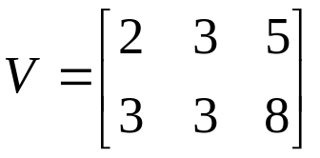
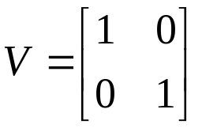
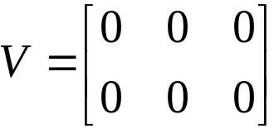
MATLAB Statements
MATLAB Statement | Remarks
V=[ 2 3 5 3 3 8]
C=[1:3:11] | C=[1 4 7 10]
Z=4\8 | Z=2
Y=eye(2)
W = zeros(2,3)

Slide 18
Logical Operators
> | Greater than
>= | Greater than or equal
< | Less than
<= | Less than or equal
== | equal
~= | Not equal

Slide 19
Logical Operators
& | AND
| | OR
~ | NOT
if (X>6) |(x<3)

Slide 20
Special matrices
ones(n) n × n-matrix with ones
ones(m,n) m × n-matrix
zeros(n) n × n-matrix with zeros
eye(n) Ones on diagonal (identity matrix of order n × n)
diag() creates a diagonal matrix from vector (another matrix)
triu(),tril() gives upper or lower triangular matrix

Slide 21
Matrix operations
B=A’ (B is transpose of A)
B= det(A) determinant
D=3*(B*C)^3 3(BC)³
inv(A) inverse of A
B=A^2 Produces the matrix product AA
A=A.^2 Squares each entry of A
Cos(A./2) divides each entry of A by 2, then takes cosine
size(A) %gives dimension of A

Slide 22
Help
A good idea is use the help
help provides information about the available functions and how to use them.
Try
  help eig
  help inv
  help roots

Slide 23
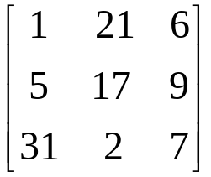


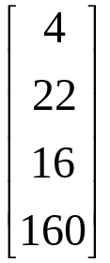
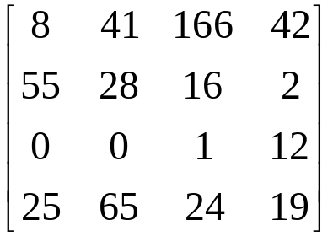
Exercises
Enter the following Matrices in matlab using spaces, commas, and semicolons to separate rows and columns:
A =
B =
D =
C =
D =
E = a 5 x 9 matrix of 1’s

Slide 24
Exercises
Use the who and whos functions to confirm all of the variables and matrices in the work space are present and correct
A =
B =
D =
C =
D =
E = a 5 x 9 matrix of 1’s

Slide 25
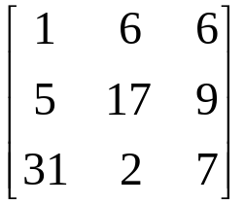
Exercises
Change the following elements in each matrix:
76
A =
B =
76
0
0
D =
76
0
C =
D =
76
E = a 5 x 9 matrix of 1’s
76

